Slide 1

Leather QA Direct-to-Cutting Program
Success Story
Thank you for exploring a partnership with us.

Slide 2
Table of Content
Section
01 Background Information and Client Value Drivers
02 Before-Impactiva Situation Found
03 Our Solution
04 Before-Impactiva and After-Impactiva

Slide 3
Background Information and Client Value Drivers
A USD $ +4 billion US global brand-retailer, a leader in athletic footwear
Facing suede split leather color and nap inconsistencies that was negatively impacting their sell-through
Seeking to improve their speed to market by reducing the number of days in their leather production-chain

Slide 4
Situation Found
After assessing the Before-Impactiva situation, Impactiva found the following root causes:
Tanneries were using different raw material origin creating major inconsistencies in quality from lot to lot and tannery to tannery (raw material is key in suede leather)
Leather Confirmation Swatches and Color Windows being used were inconsistent across the brand-retailer’s leather ecosystem

Slide 5
Our Solution
Standards:
  Define and create tools to be used by Client’s leather ecosystem
  (Leather Specs, Leather Confirmation Swatches, Color Windows, Range Swatches such as Nap Standard and Product Article)
  Worked with tanneries and Client to determine and specify raw material that resulted in best quality while maintaining same leather costs
Tannery permanent deployment:
  Impactiva Leather QA Technicians
  (performed manual tests, color shade separation and QC on 100% of leather)
  Impactiva Leather Marking Technicians
  (marked the defects on 100% of leather)

Slide 6
Our Solution
“Direct-to-Cutting” Program:
  After initial “get-to-know” period, 100% of leather is sent directly to cutting without a Factory re-inspection
Factory Technical Support deployment:
  Impactiva Client-Success Technicians
    Teach Factory Warehouse Team on Client’s leather standards
    Teach Factory Warehouse Team on Impactiva’s grading and color-shade system* so that the leather can go directly to cutting
    * Under Impactiva’s guidance, Tanneries ship all leather separated by grades (1, 2, 3) and color shades (max. of 4) with bundles marked accordingly

Slide 7
Before-Impactiva Status of Leather Production
Tannery 1
  Cow Split suede is relatively firm with consistent short nap
  Inconsistent product quality across the production batches, with average sizes being:
    13 sq. ft.
    21 sq. ft. (roughly 10% of material is 25 sq. ft.)
  Not using same origin of raw materials across their production

Slide 8
Before-Impactiva Status of Leather Production
Tannery 2
  Suede is soft but with inconsistent medium to long nap
  Inconsistent product quality across the production batches, with a large disparity in skin sizes:
    8 sq. ft.
    12 sq. ft.
    15 sq. ft.
    20 sq. ft. (there are batches with single butt half-hide as well as double butt full-hide)
  Not using the same origin of raw materials across their production

Slide 9
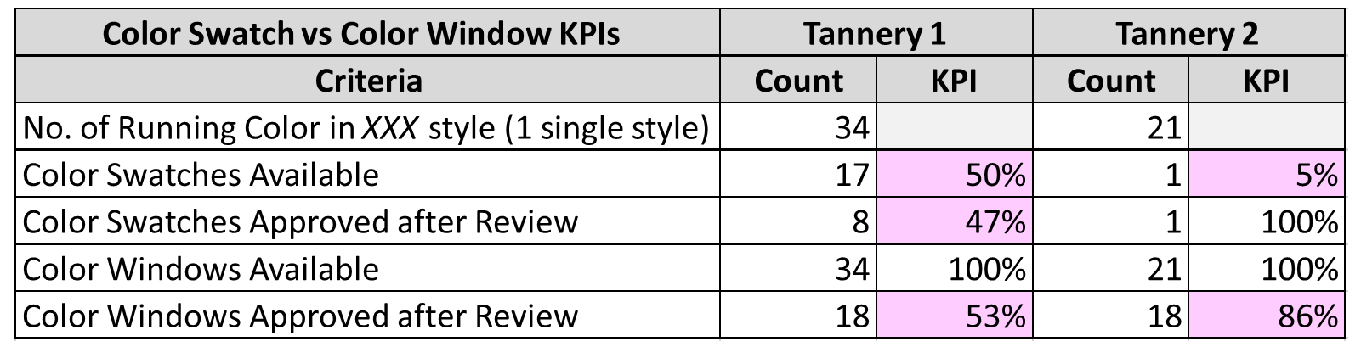
Color Variation Analysis
Missing many client approved Leather Confirmation Swatches (LCS’s)
Primarily following Color Windows (CW’s), which should only be used as a supporting tool to judge the acceptable tolerance levels, not as the primary standard

Slide 10
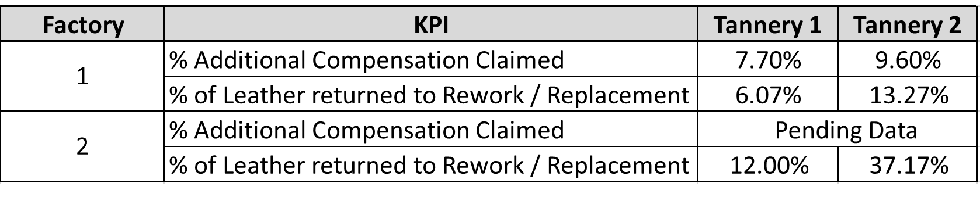
Cost of Poor Quality
Before-Impactiva Previous-Year Claim Summary

Slide 11
Average % Clean Area Arriving at T1 vs % Contracted

Slide 12
Average % Clean Area Improvement Arriving at T1

Slide 13
Tannery Before-Shipment KPIs
Order Rejected at First Inspection for Improvement at Tannery 1

Slide 14
Tannery Before-Shipment KPIs
Order Rejected at First Inspection for Improvement at Tannery 2

Slide 15
Tannery Before-Shipment KPIs
Order Rejected at First Inspection for Improvement - Overall

Slide 16
Tannery Before-Shipment KPIs
Pcs. Rejected during 100% Inspection at Tannery 1

Slide 17
Tannery Before-Shipment KPIs
Pcs. Rejected during 100% Inspection at Tannery 2

Slide 18
Tannery Before-Shipment KPIs
Pcs Rejected during 100% Inspection - Overall

Slide 19
Top 3 Defective Leathers Stopped at Tannery – Tannery 1

Slide 20
Top 4 Defective Leathers Stopped at Tannery – Tannery 2

Slide 21
Tannery Before-Shipment KPIs - % Clean Area Improvement

Slide 22
Factory 1 Leather Claim KPIs - After Impactiva Inspection

Slide 23
Factory 1 Leather Claim KPIs – After Impactiva Inspection
Description | Jul | Aug | Sep | Oct | YTD
Sq. Ft. Shipped | 11,642 | 156,412 | 531,366 | 184,990 | 884,410
Sq. Ft. w/ Problems | 98 | 441 | - | - | 539
% Sq. Ft. w/ Problems | 0.8% | 0.3% | 0.0% | 0.0% | 0.1%

Slide 24
Factory 1 Quality Statistics – Before & After Impactiva
Description | Tannery 1 | Tannery 2
% of Sq. Ft. requiring replacement before Impactiva | 6.1% | 13.3%
% of Sq. Ft. requiring replacement after Impactiva | 0.0% | 0.0%

Slide 25
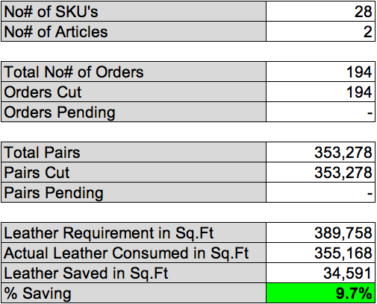
Cutting Yield Improvement at Factory 1
9.7% savings versus consumption standards defined on Satra Summ or equivalent software

Slide 26
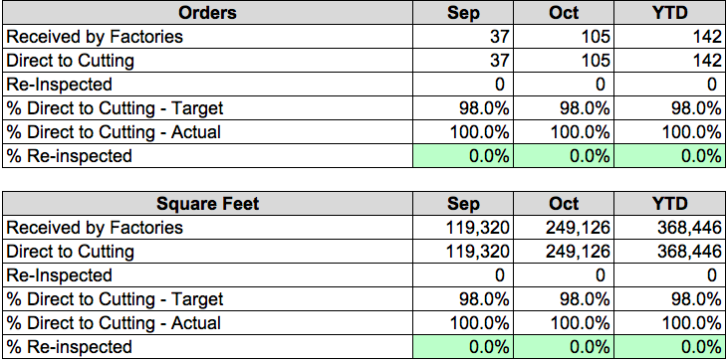
Direct-to-Cutting Results at Factory 1

Slide 27
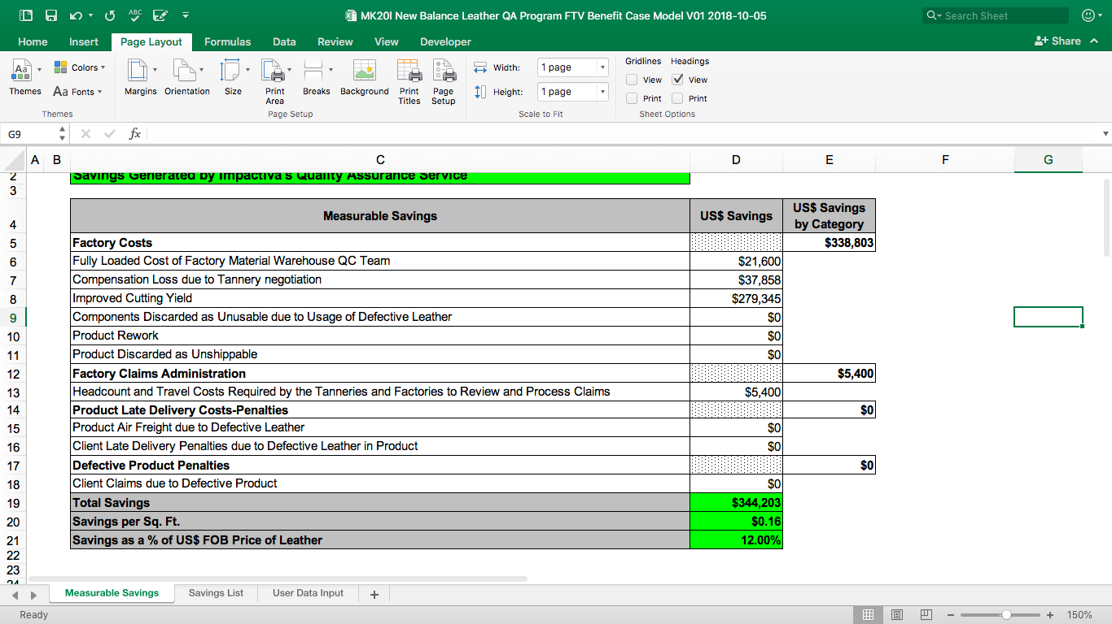
Return On Investment of Factory 1

Slide 28
Lead-Time Improvement

Slide 29
Contact Us: sales@impactiva.com
Notes:
Quality of the logo

